Slide 1
DEPARTMENT OF PHYSICS
SRM INSTITUTE OF SCIENCE AND TECHNOLOGY
18PYB103J –Semiconductor Physics
18PYB101J Module-IV Lecture-9

Slide 2
EXTRINSIC SEMICONDUCTOR
In an extrinsic semiconducting material, the charge carriers originate from impurity atoms added to the original material is called impurity [or] extrinsic semiconductor.
This Semiconductor obtained by doping TRIVALENT and PENTAVALENT impurities in a TETRAVALENT semiconductor. The electrical conductivity of pure semiconductors may be changed even with the addition of few amount of impurities.
18PYB103J Module-II Lecture-2

Slide 3
DOPING
The method of adding impurities to a pure semiconductor is known as DOPING, and the impurity added is called the dopping agent(Ex-Ar,Sb,P,Ge and Al).
The addition of impurity would increases the no. of free electrons and holes in a semiconductor and hence increases its conductivity.
SORTS OF SEMICONDUCTOR according to ADDITION OF IMPURITIES
n-type semiconductor
p-type semiconductor
18PYB1013J Module-II Lecture-2

Slide 4
N – type semiconductor
When penta-valent impurity is added to the intrinsic semiconductors, n type semi conductors are formed
Fig1.1
n - type semiconductor
At T = 0K
18PYB103J Module-II Lecture-2
Notes:
Fig1.1
Fig1.1

Slide 5
When small amounts of penta-valent impurity such as phosphorous are added during crystal formation, the impurity atoms lock into the crystal lattice[ see above Fig1.1).
Consider a silicon crystal which is doped with a fifth column element such as P, As or Sb.
Four of the five electrons in the outermost orbital of the phosphorus atom take part in the tetrahedral bonding with the four silicon neighbors.
The fifth electron cannot take part in the discrete covalent bonding. It is loosely bound to the parent atom.
18PYB103J Module-II Lecture-2

Slide 6
It is possible to calculate an orbit for the fifth electron assuming that it revolves around the positively charged phosphorus ion, in the same way as for the “1s” electron around the hydrogen nucleus.
The electron of the phosphorus atom is moving in the electric field of the silicon crystal and not in free space, as is the case in the hydrogen atom.
This brings in the dielectric constant of the crystal into the orbital calculations, and the radius of the electron orbit here turns out to be very large, about 80 Å, as against 0.5 Å for the hydrogen orbit. Such a large orbit evidently means that the fifth electron is almost free and is at an energy level close to the conduction band.
18PYB103J Module-II Lecture-2

Slide 7
At OK, the electronic system is in its lowest energy state, all the valence electron will be in the valence band and all the phosphorous atoms will be un-ioniszed.
The energy levels of the donor atoms are very close to the conduction band.
In the energy level diagram, the energy level of the fifth electron is called donor level. The donor level is so close to the bottom of the conduction band.
Most of the donor level electrons are excited into the conduction band at room temperature and become majority charge carriers.
18PYB103J Module-II Lecture-2

Slide 8
At T > 0K
At T = 300K
If the thermal energy is sufficiently high, in addition to the ionization of donor impurity atoms, breaking of covalent bonds may also occur thereby giving rise to generation of electron hole pair.
18PYB103J Module-II Lecture-2

Slide 9
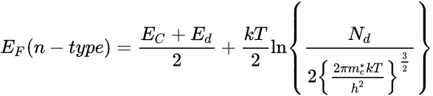
Fermi energy
The Fermi energy for n – type semiconductor is given by
At 0 K,
Variation of Fermi level with temperature
The Fermi energy is given by,
Let
18PYB103J Module-II Lecture-2

Slide 10
Variation of Fermi level with donor concentration with temperature
As T increases, Fermi level drops. Also for a given temperature the Fermi level shift upward as the concentration increases.
We can say that E_{F} decreases slightly with increase in temperature.
As the temperature is increased, more and more donor atoms are ionized. For a particular temperature all the donor, atoms are ionized.
18PYB103J Module-II Lecture-2

Slide 11
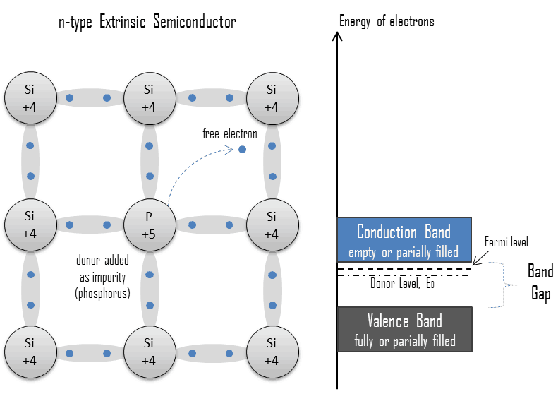

Slide 12
Further increase in temperature results in generation of electron-hole pairs due to the breaking of covalence bonds and the material tends to behave in intrinsic manner. The Fermi level gradually moves towards the intrinsic Fermi level E_{i} .
P -Type Semiconductor
When trivalent impurity is added to intrinsic semiconductor, P type semi conductors are formed.
Al has three electrons in the outer orbital. While substituting for silicon in the crystal, it needs an extra- electron to complete the tetrahedral arrangement of bonds around it.
18PYB103J Module-II Lecture-2

Slide 13
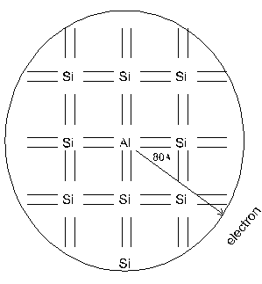
The extra electron can come only from one of
the neighboring silicon atoms, thereby creating a vacant electron site (hole) on the silicon.
The Aluminium atom with the extra electron becomes a negative charge and the hole with a positive charge can be considered to resolve around the aluminium atom, leading to the same orbital calculations as aboveT.
p - type semiconductor
At T = 0K
18PYB103J Module-II Lecture-2

Slide 14
Since the trivalent impurity accepts an electron, the energy level of this impurity atom is called acceptor level. This acceptor level lies just above the valence bond.
Even at relatively low temperatures, these acceptor atoms get ionized taking electrons from valence bond and thus giving to holes in the valence bond for conduction.
Due to ionization of acceptor atoms, only holes and no electrons are created.
18PYB101J Module-IV Lecture-9

Slide 15
If the temperature is sufficiently high, in addition to the above process, electron-hole pairs are generated due to the breaking of covalent bonds.
Thus holes are more in number than electrons and hence holes are majority carriers and electrons are minority carriers
(a) At T > 0K (b) At T = 300K
18PYB101J Module-IV Lecture-9

Slide 16
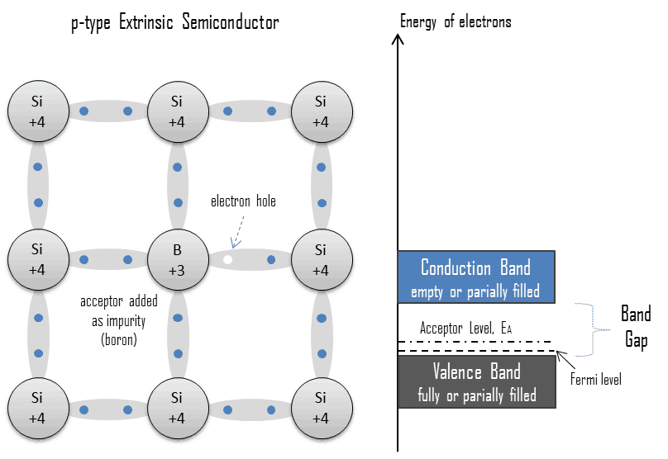
18PYB103J Module-II Lecture-2

Slide 17
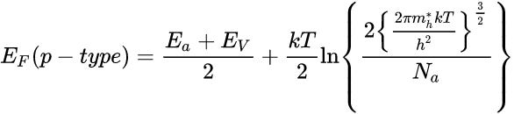
Fermi Energy
The Fermi energy for p – type semiconductor is given by
At 0 K,
At 0K, Fermi level is exactly at the middle of the acceptor level on the top of the valence band.
18PYB103J Module-II Lecture-2

Slide 18

VARIATION OF FERMI LEVEL WITH
TEMPERATURE
=
where N_{y} = 2
and therefore E_{F} =
From the above eqn, it is seen that E_{F} increases slightly as the temperature increases.
As the temperature increases, more and more acceptor atoms are ionised.

Slide 19
For a particular temperature all the acceptor atoms are ionized.
Further increase in temperature results in generation of electron-hole pair due to the breaking of covalent bonds and the material tend to behave in intrinsic manner.
The Fermi level gradually moves towards the intrinsic Fermi level.
N_{a}
N_{a}
18PYB103J Module-II Lecture-2

Slide 20
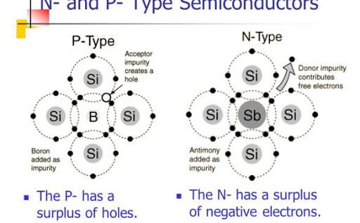
18PYB103J Module-II Lecture-2

